Slide 1

Automated Exercise Generation for an Algorithmics Course
Zoltan Sojtory

Slide 2
What is Automated Exercise Generation?
Producing many distinct variants of an exercise
Three main areas
Generating new problems
Generating solutions
Automatic grading
Each have their own difficulties

Slide 3
Motivation / Previous Works
Online Examinations
Previous papers
Embedded systems MOOCs - D. Sadigh, S. A. Seshia, and M. Gupta. Automating Exercise Generation: A Step towards Meeting the MOOC Challenge for Embedded Systems
Satisfiability problems - P. Hozzová, L. Kovács, and J. Rath. Automated Generation of Exam Sheets for Automated Deduction
Data Science - C. Kotsiopoulos, I. Doudoumis, P. Raftopoulou, and C. Tryfonopoulos. DaST: An Online Platform for Automated Exercise Generation and Solving in the Data Science Domain
None discuss graph/string algorithms from Algorithmics Courses

Slide 4
Chosen algorithms
Focus on problem and solution generation
Dijkstra’s Algorithm (shortest path)
The exercises generated ask students to identify the shortest paths from a given a vertex to all other vertices in a weighted graph.
KMP Algorithm (string search)
For this exercise, students are required to build the border table of a given string, so that the KMP algorithm can be applied to search for a string.

Slide 5
Approach / Difficulties
Challenges with problem generation
Ensuring uniform difficulty
Template Based Approach
By reviewing existing, handwritten problems
Identify characteristics which alter difficulty

Slide 6
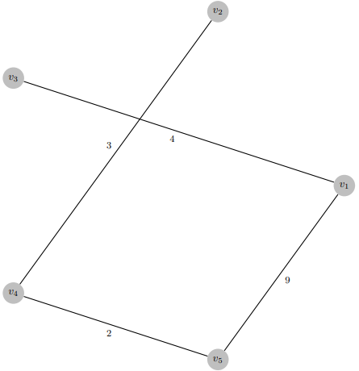
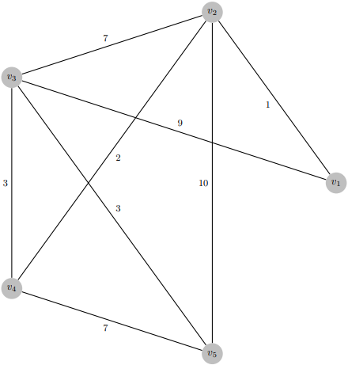
Dijkstra Template
Number of vertices (User input)
Number of edge relaxations (User input)
Number of edges
Edge weights

Slide 7
KMP Template
String size (User input)
Longest border size (User input)
Overlapping or Non-overlapping longest border (User input)
“ababa..........” (Overlapping) vs “aba…….aba….” (Non-overlapping)
Alphabet

Slide 8
Dijkstra Generation Algorithm
Generate the lengths of the shortest paths to each vertex from the starting vertex.
Insert vertices into the graph by connecting them based on their shortest distances.
Insert additional edges for edge relaxations, creating the final graph.

Slide 9
5 vertices, 3 edge relaxations example
1.
V1 | V2 | V3 | V4 | V5
0 | 3 | 6 | 8 | 12

Slide 10
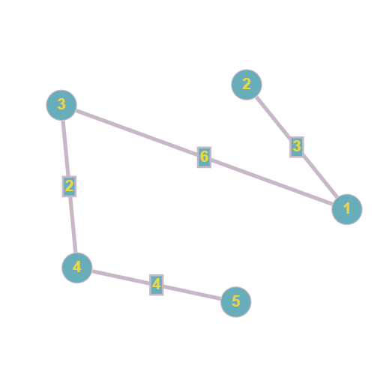
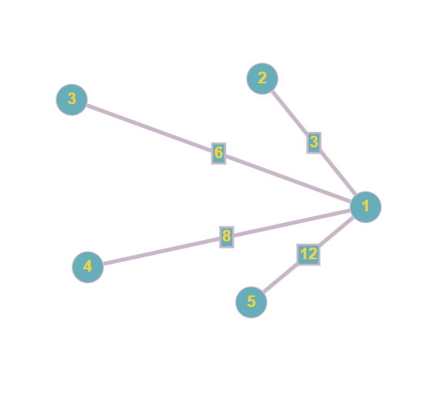



5 vertices, 3 edge relaxations example
2. Insertion must be dynamic.

Slide 11
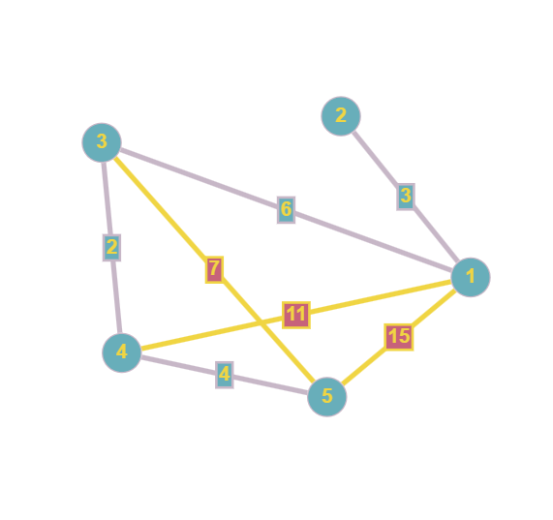
5 vertices, 3 edge relaxations example
3.

Slide 12
KMP Generation Algorithm
1. Generate the largest border.
2. Fill out the rest of the string.

Slide 13
13 length, 4 length longest non-overlapping border example
[_, _, _, _, _, _, _, _, _, _, _, _, _, _] (alphabet: {C, G, T})
Randomly generated largest border: CGGT
Inserted at random location (and beginning):
[C, G, G, T, _, _, _, _, C, G, G, T, _]
Ensure subsequent characters do not match:
[C, G, G, T, C, _, _, _, C, G, G, T, C]
[C, G, G, T, C, _, _, _, C, G, G, T, T]

Slide 14



13 length, 4 length longest non-overlapping border example
2. Fill in empty spaces with random characters from alphabet:
[C, G, G, T, C, G, G, T, C, G, G, T, T]
Ensure no repetitions of longest border:
[C, G, G, T, C, G, G, T, C, G, G, T, T] → [C, G, G, T, G, G, G, T, C, G, G, T, T]

Slide 15
Implementation
Java object oriented approach
LaTeX generation
PDF rendering

Slide 16
Evaluation
1. How similar are generated exercises/solutions to pre-existing example exercises/solutions of the same type?
2. What are some of the ethical implications of automatic exercise generation?
3. How good is the usability of the application?
4. To what extent are controlled and uncontrolled variables handled effectively?

Slide 17
Conclusion
Summary
Future work
In-depth proofs
Further studies

Slide 18
Sources
G. Eshiba-Emir. Automated exercise generation for three satisfiability checking algorithms, 2022.
P. Hozzová, L. Kovács, and J. Rath. Automated Generation of Exam Sheets for Automated Deduction. PhD thesis, TU Wien, 2021.
C. Kotsiopoulos, I. Doudoumis, P. Raftopoulou, and C. Tryfonopoulos. DaST: An Online Platform for Automated Exercise Generation and Solving in the Data Science Domain. PhD thesis, University of Peloponnese, 2019.
D. Sadigh, S. A. Seshia, and M. Gupta. Automating Exercise Generation: A Step towards Meeting the MOOC Challenge for Embedded Systems. PhD thesis, UC Berkeley, 2012.

